Slide 1
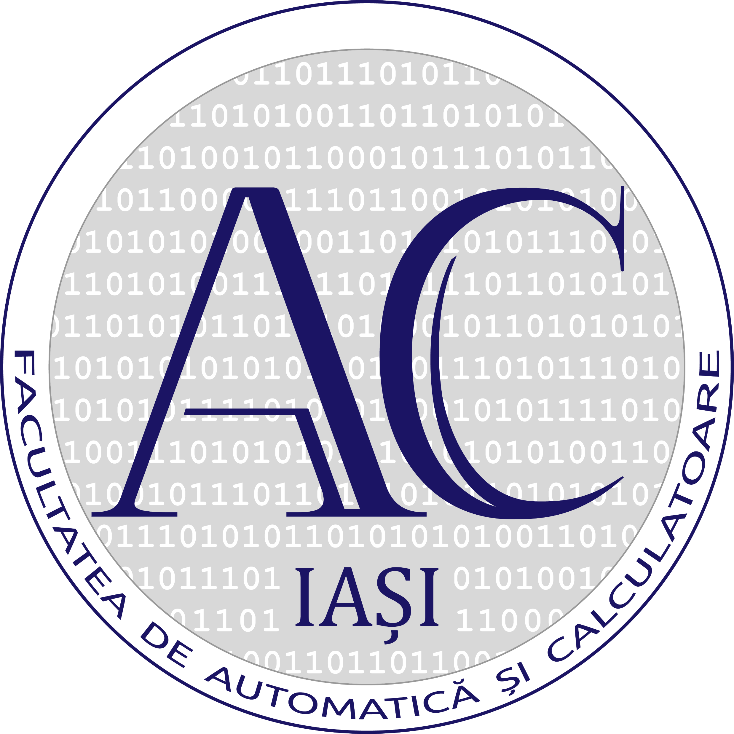


A Comprehensive Approach to Accurate
Anthropometric Data Acquisition
Domeniu:Computers and Information Technology
Program de studii:Information Technology
Year of study: 4
Vlad-Ionut Apostol, Daniel-Eduard Lupu
Supervisor: Stefan-Daniel Achirei

Slide 2
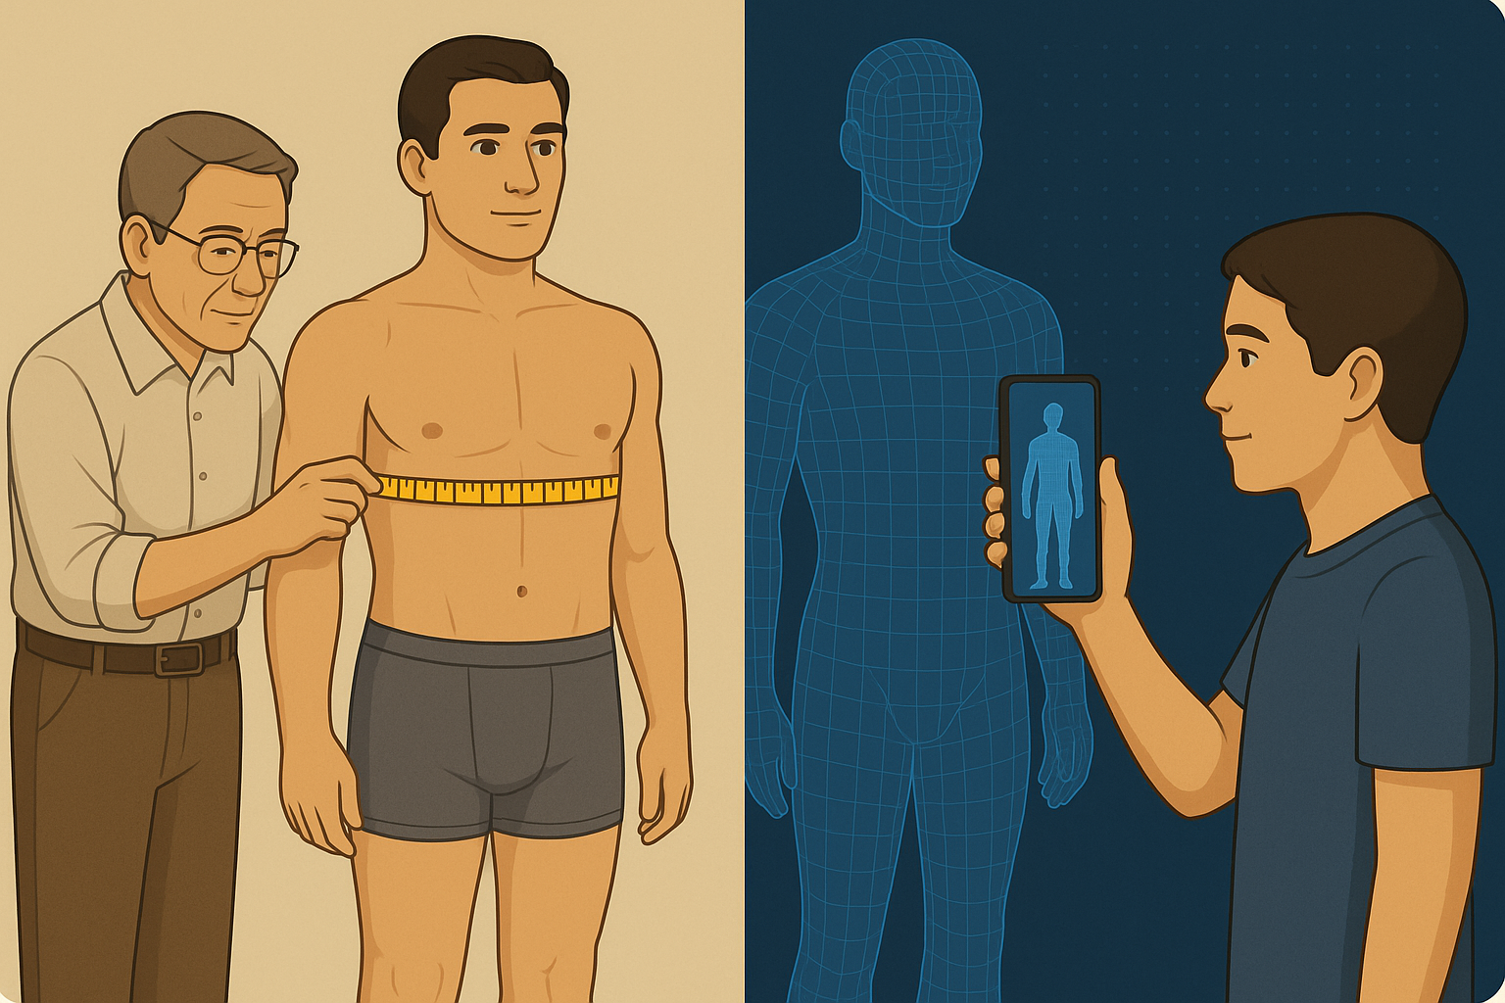
Introduction
Commonly used in fashion, health-care
Manual measurements are slow
Mobile-based app for measurements

Slide 3
Objective
Developing a user-friendly mobile app
Using LiDAR and photogrammetry to obtain an accurate 3d model.
Automating the process
Creating a scalable and portable solution

Slide 4
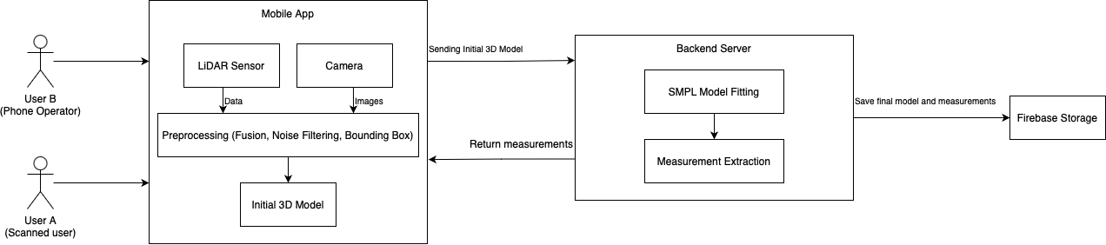
Methodology

Slide 5
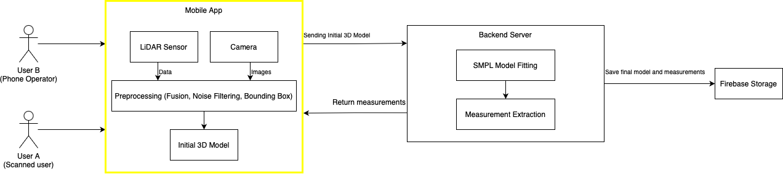
Methodology - Mobile
Bounding Box - Eliminates noise data
Depth Data and Images
Fusion on device for an initial 3D model

Slide 6
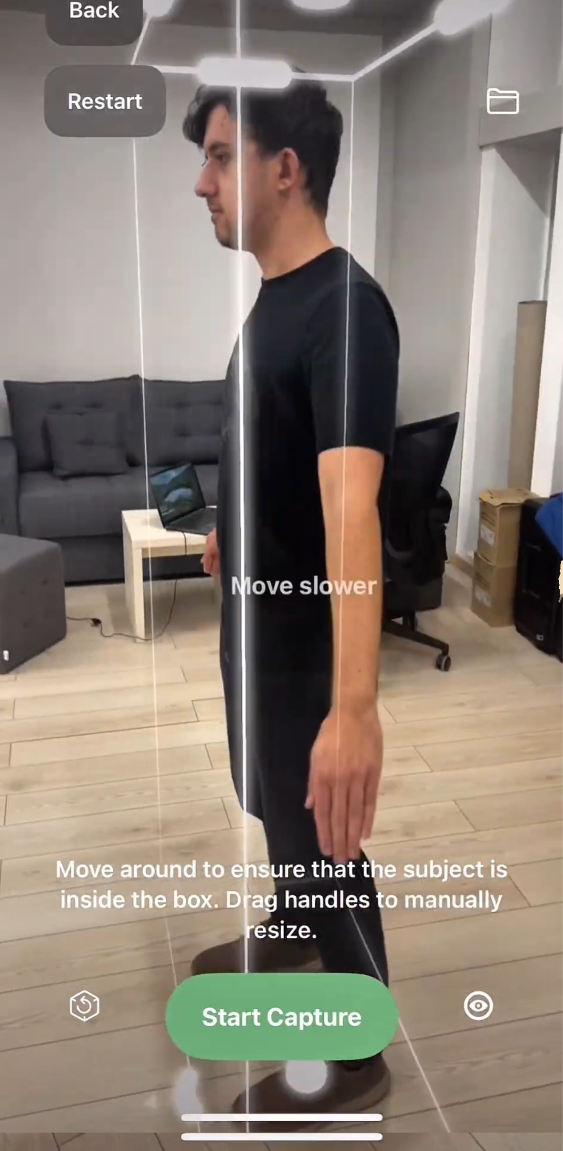
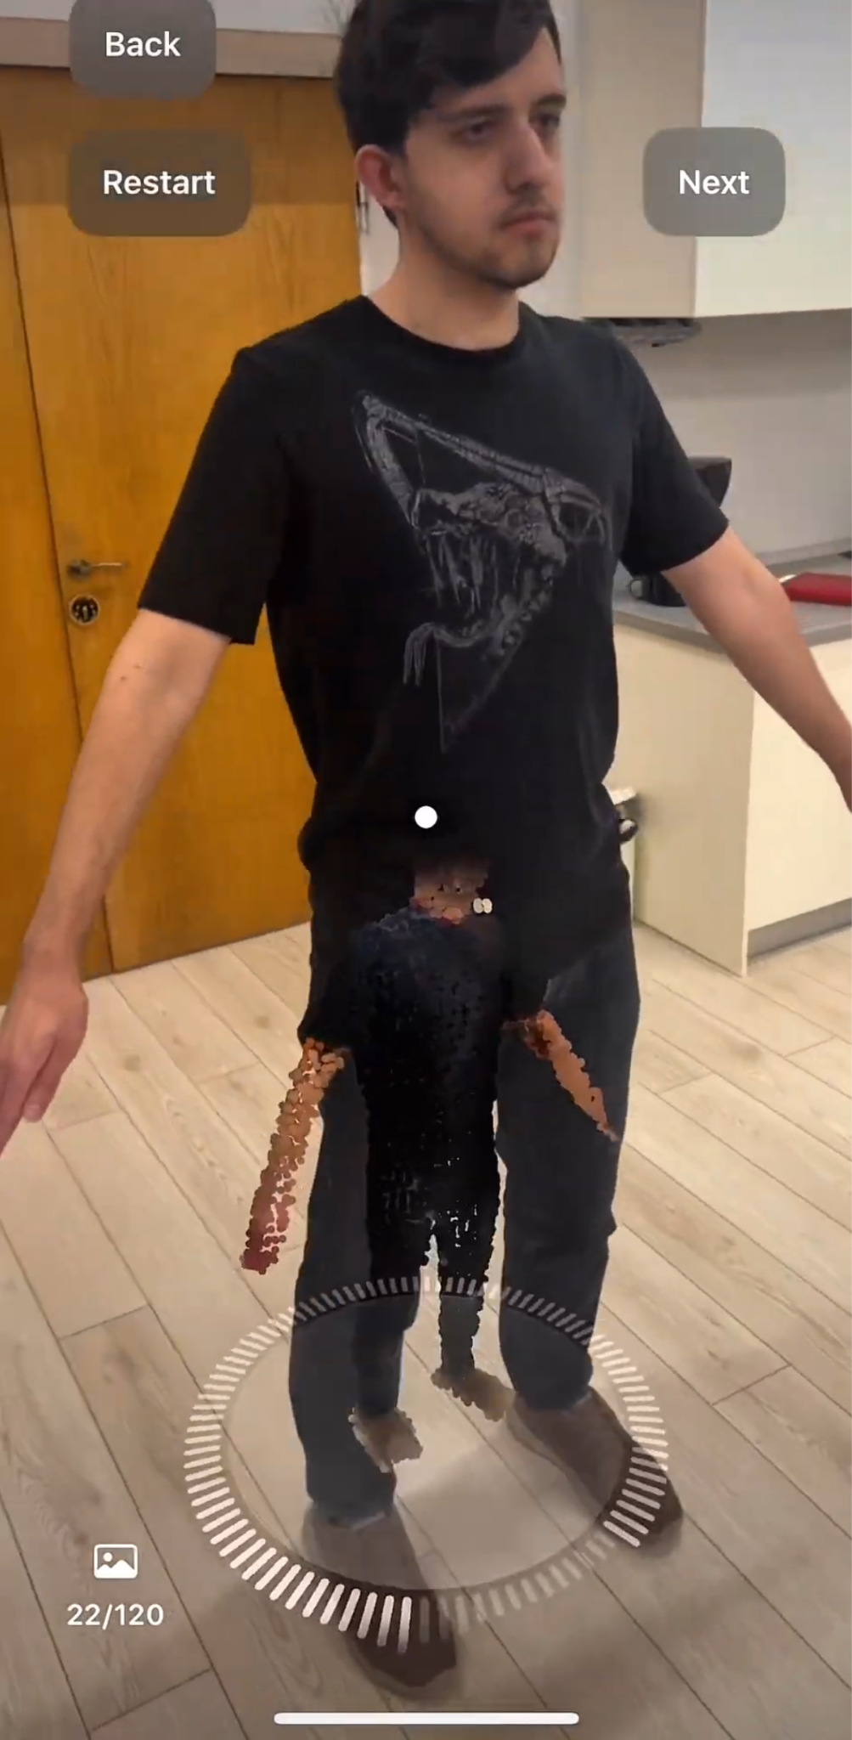
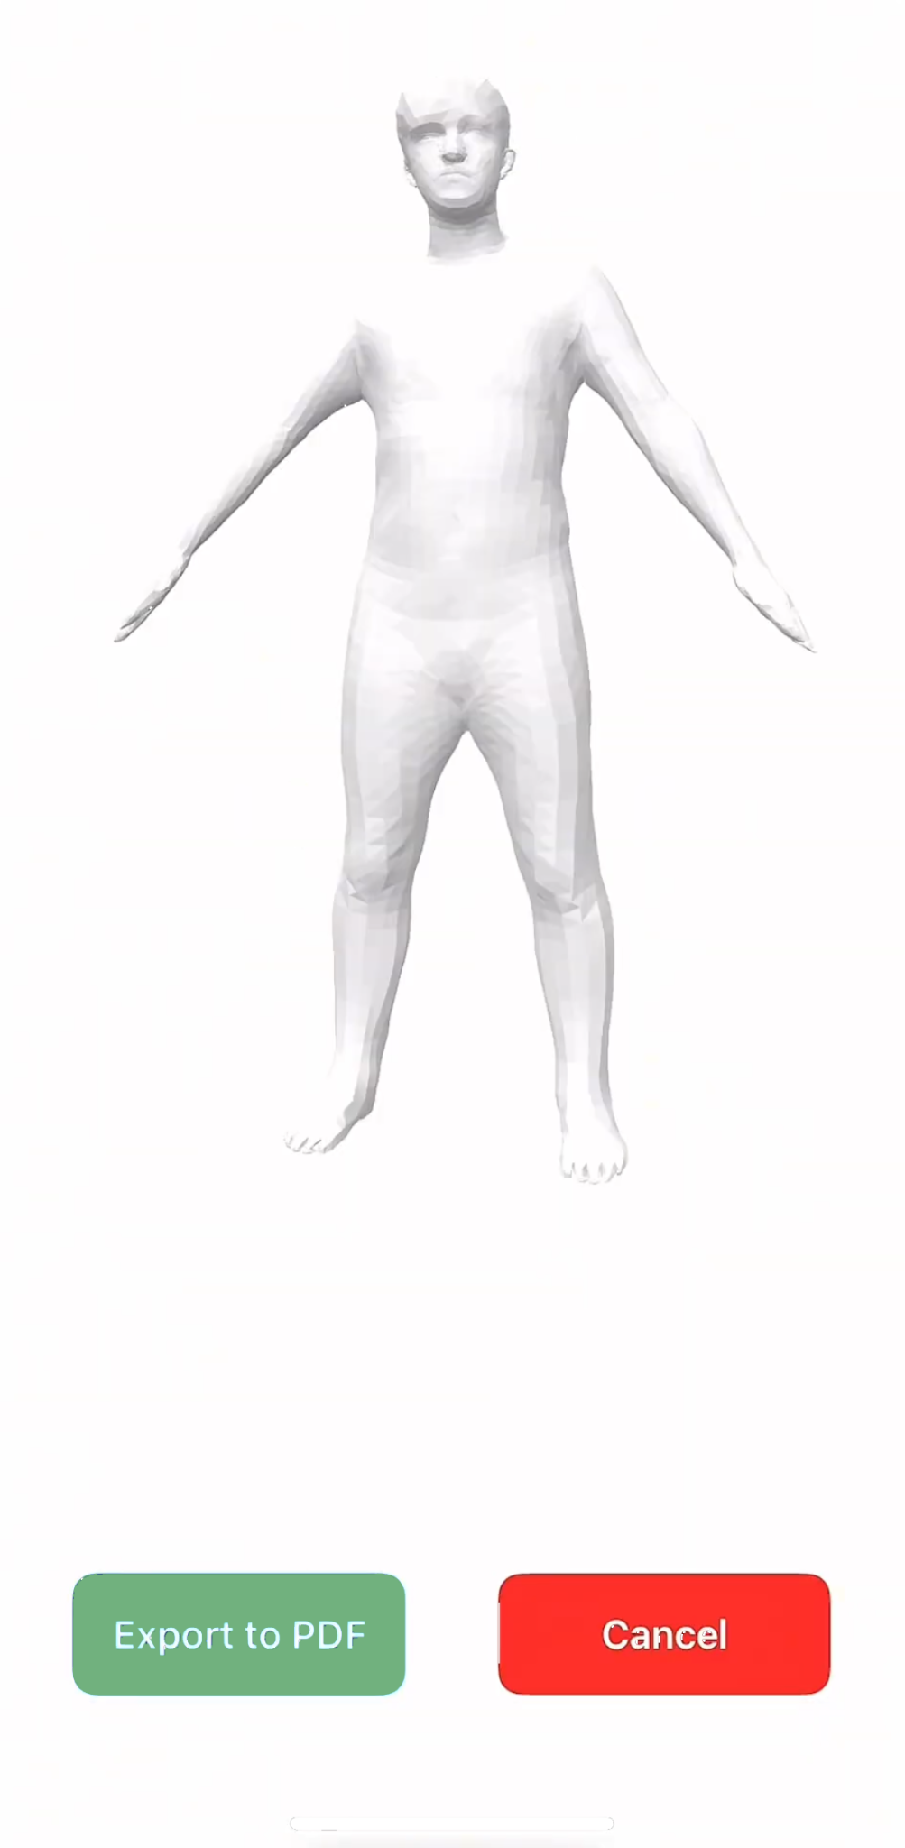
Methodology - Mobile

Slide 7
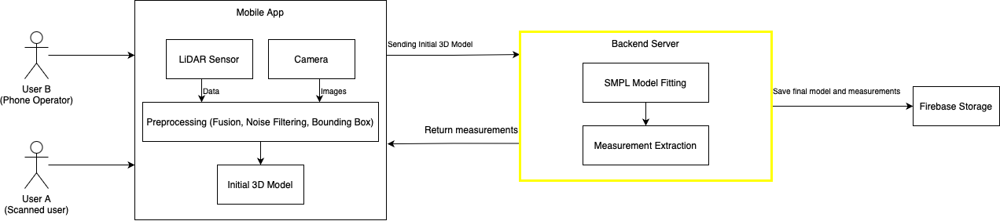
Methodology - Backend Server
Iterative Closest point (ICP) - Fits SMPL model to the human scan
non-linear Support Vector Regressor (SVR) -> 375 subjects
Transfering outcome to Firebase

Slide 8
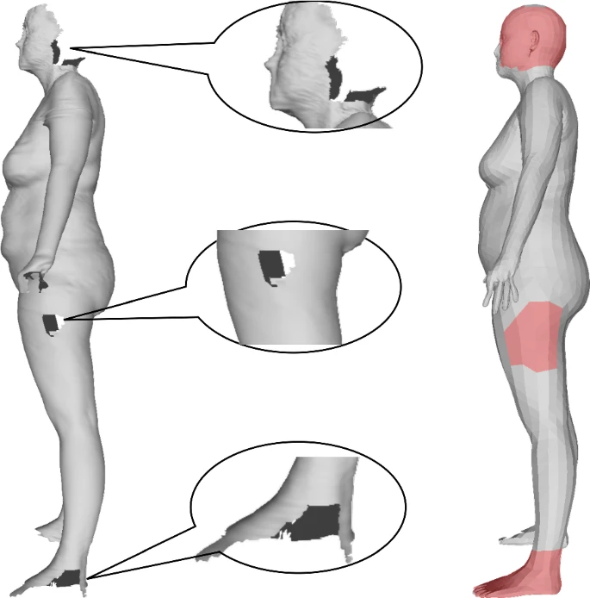
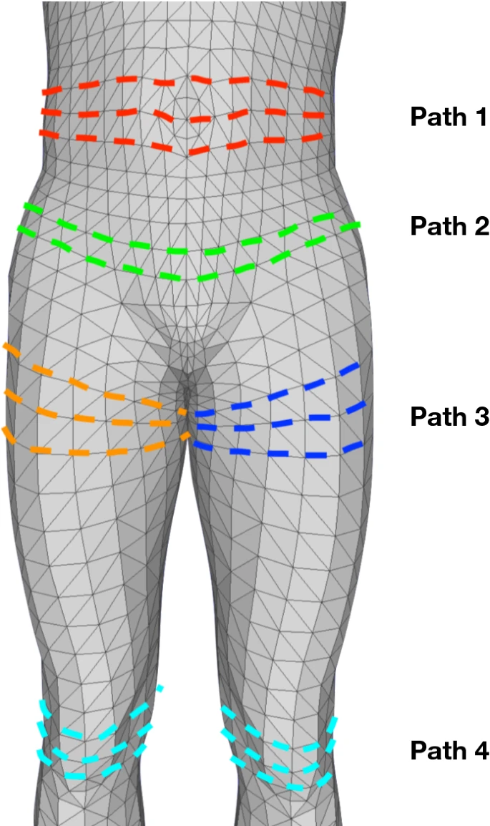
Methodology - Backend Server
Iterative Closest Point
Fits SMPL model to the human scan
Surface measurements

Slide 9
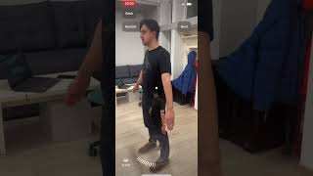
Methodology - Demo

Slide 10
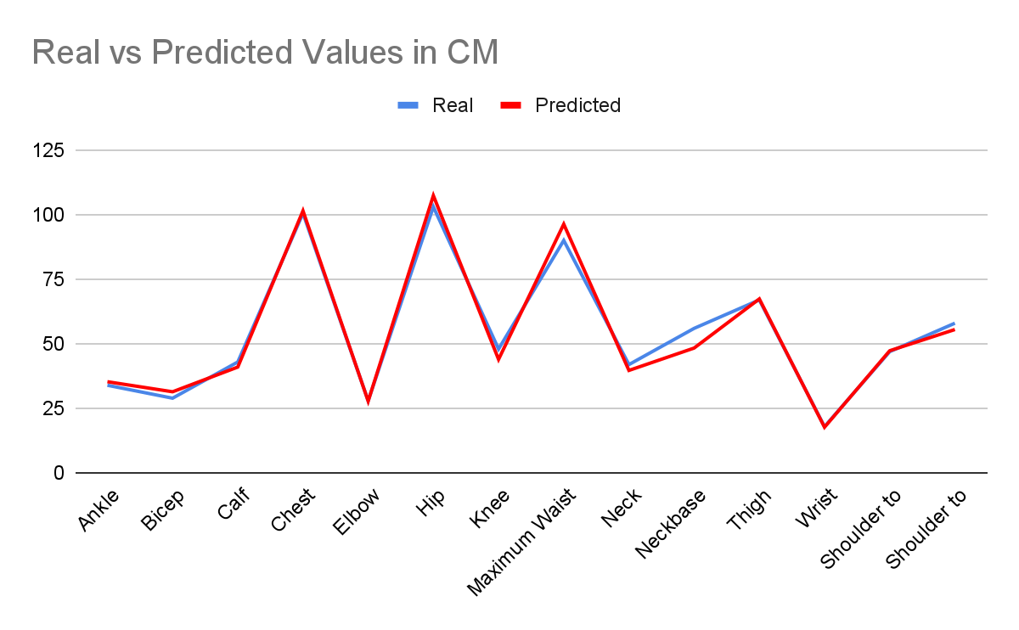
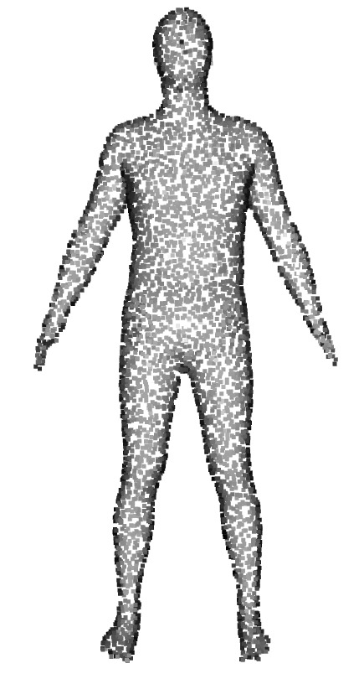
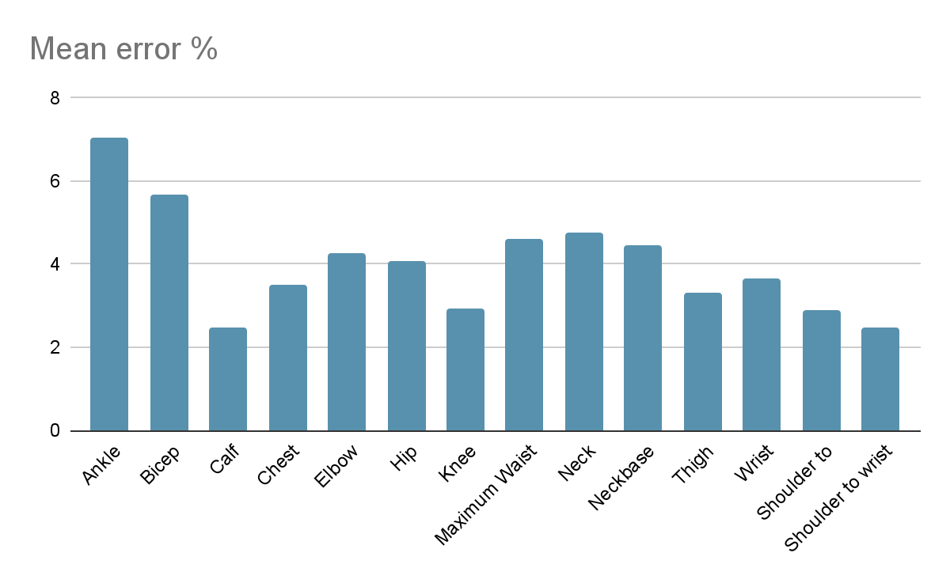
Results

Slide 11
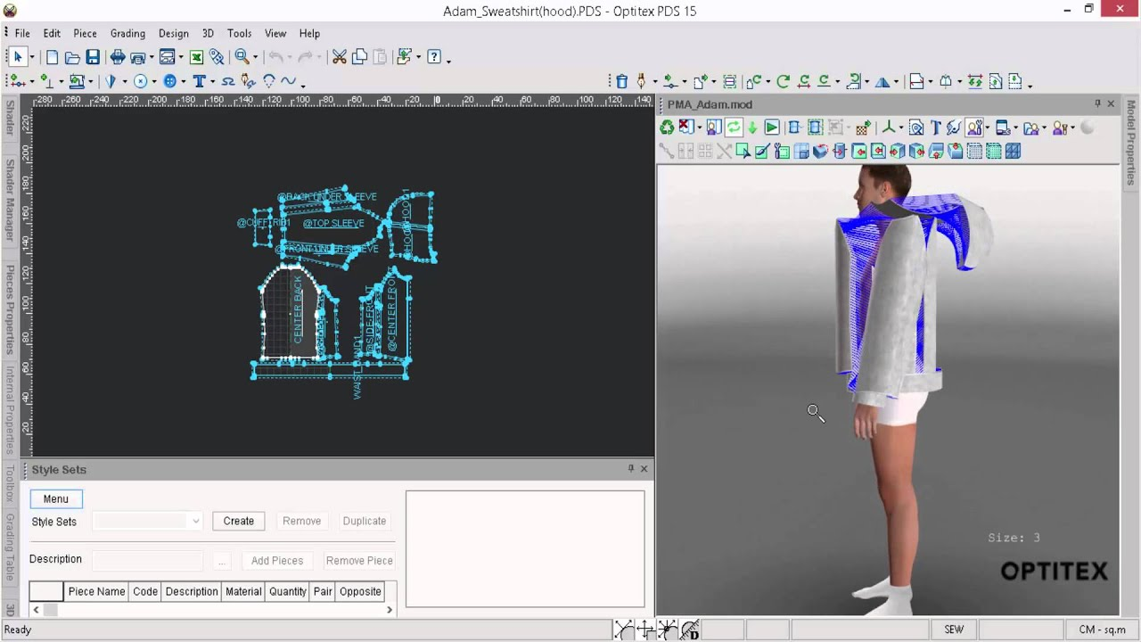
Future Work
Integration with a CAD for clothing design
Improve accuracy

Slide 12
Contributions
Vlad-Ionut Apostol:
Designed and implemented the mobile application using LiDAR and photogrammetry.
Integrated image and depth data fusion to generate the initial 3D human model.
Daniel-Eduard Lupu:
Developed the backend server responsible for 3D model processing and measurement extraction.
Implemented the SMPL fitting pipeline using Iterative Closest Point (ICP) and regression techniques.

Slide 13
Conclusions
Accurate body measurements using just a smartphone
SMPL fitting + ML model = <5% average error
Scalable solution for fashion, health, and AR industries

Slide 14
Thank you for your time!

